Slide 1

Task 2
Disease
PREDICTION
Ibrahim Tarek Abdelazeem

Slide 2

Table of
CONTENTS
01
02
03
04
initializing
Dataset
Data Preprocessing
Our model
05
06
prediction
accuracy

Slide 3
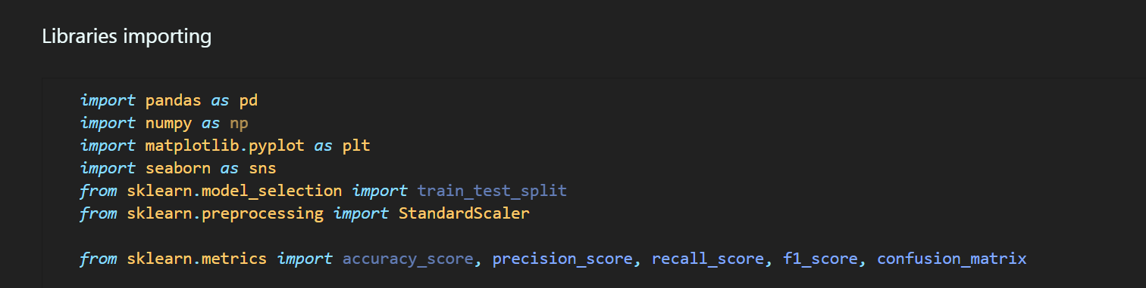
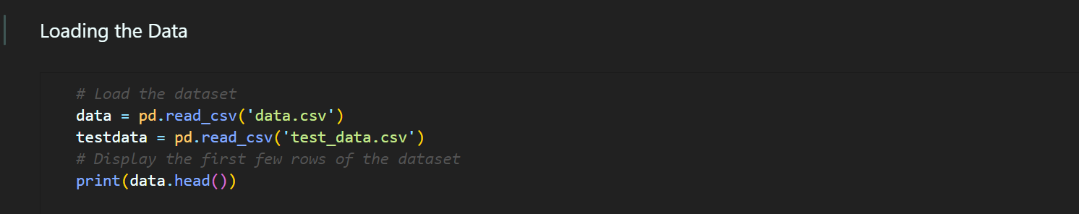
INITIALIZING

Slide 4

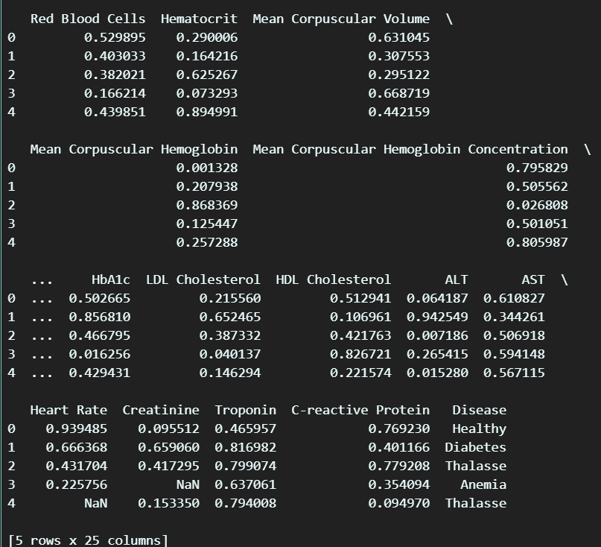
DATASET
Glucose,
Cholesterol,
Hemoglobin,
Platelets,
White Blood Cells,
Red Blood Cells,
Hematocrit,
Mean Corpuscular Volume,
Mean Corpuscular Hemoglobin,
Mean Corpuscular Hemoglobin Concentration,
Insulin,
BMI,
Systolic Blood Pressure,
Diastolic Blood Pressure,
Triglycerides,
HbA1c,
LDL Cholesterol,
HDL Cholesterol,
ALT,
AST,
Heart Rate,
Creatinine,
Troponin,
C-reactive Protein,
Disease

Slide 5

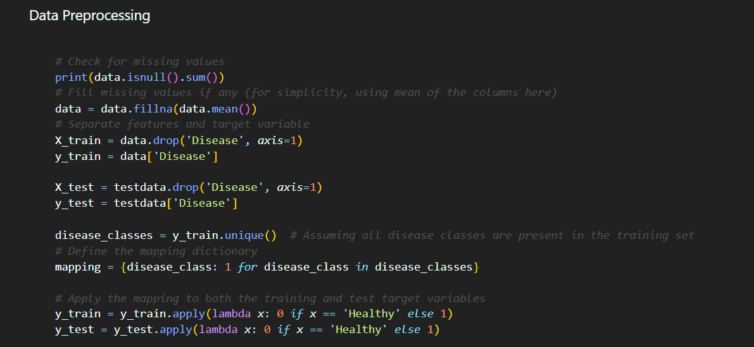
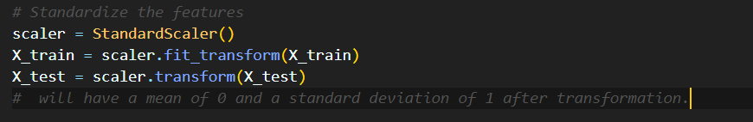
DATA PREPROCESSING

Slide 6
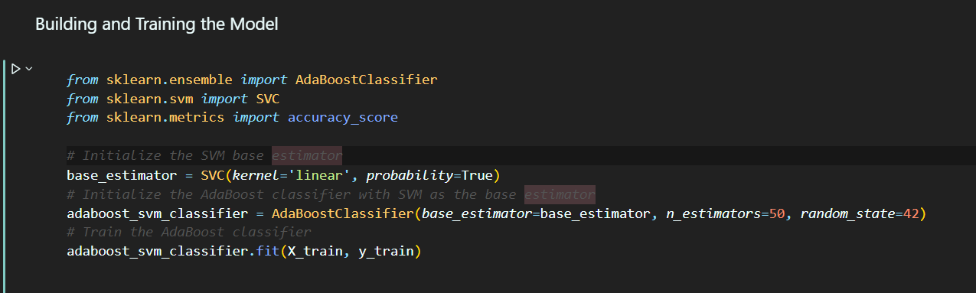
OUR MODEL

Slide 7

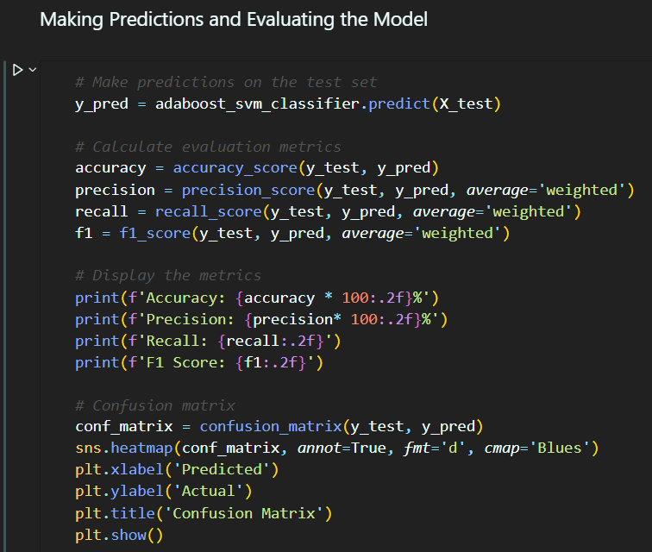
PREDICTION

Slide 8
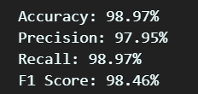
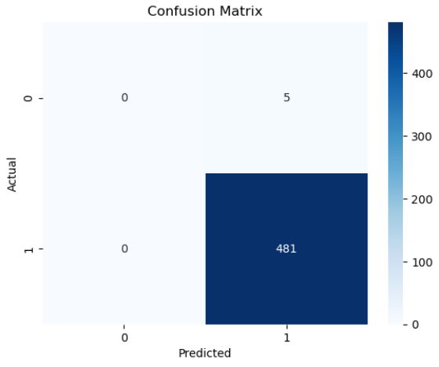
ACCURACY

Slide 9

THANK YOU

